Slide 1



















Virtual Ring Try-On
27.01.2025 – 31.01.2025

Slide 2



Overview
Introduction to Linear Algebra
Rendering Virtual Objects
Introduction to Augmented Reality
Depth Data
How a Camera Sees the World
RGBD Processing
Pinhole Camera Model
Task Overview
3D Structures for AR
Useful Links

Slide 3
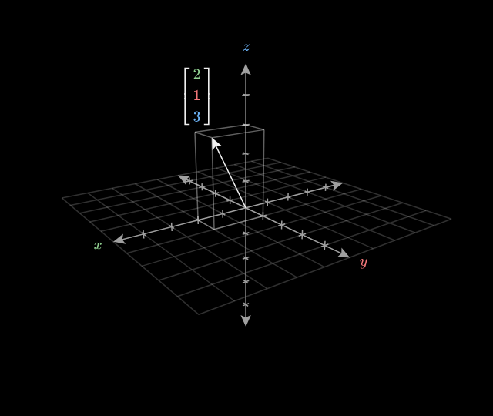
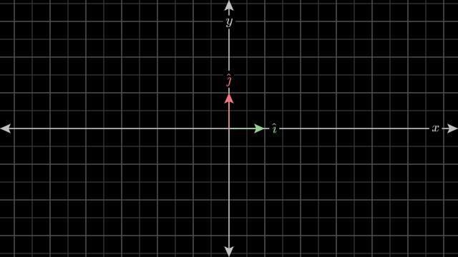
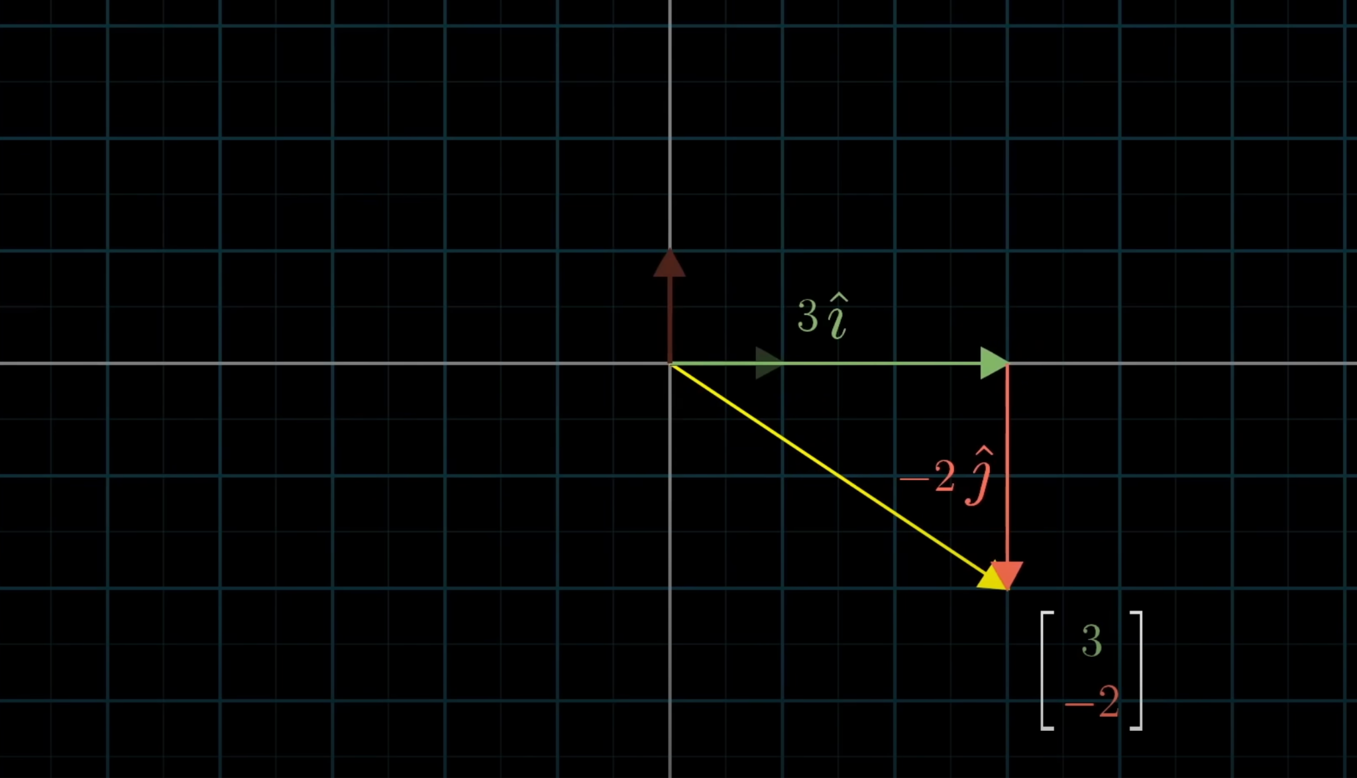
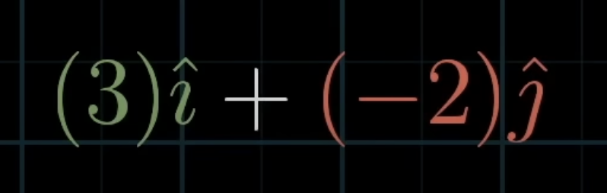
Introduction to Linear Algebra: Vectors

Slide 4
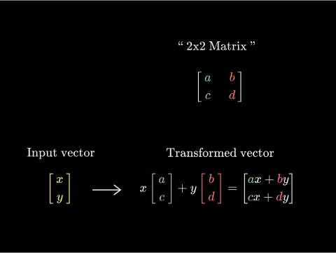
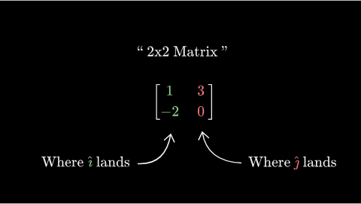
Introduction to Linear Algebra: Matrices

Slide 5
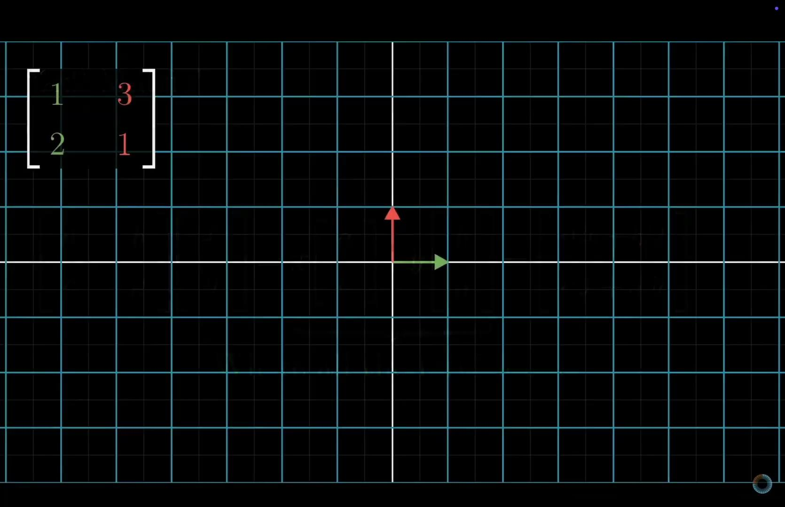
Introduction to Linear Algebra: Matrices

Slide 6
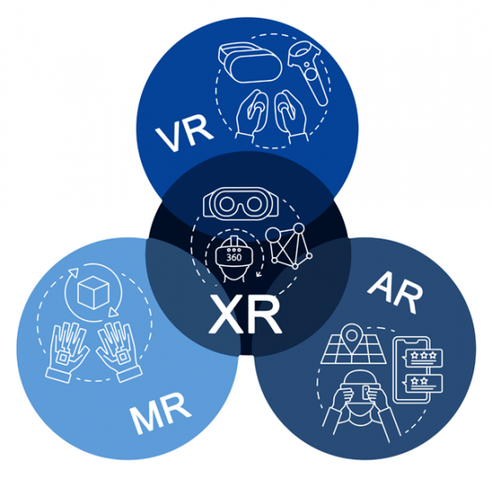
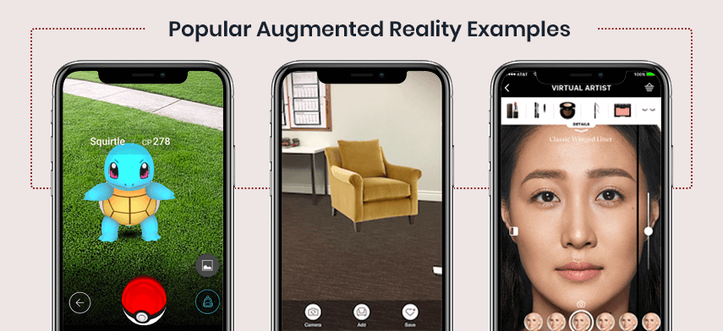
Introduction to Augmented Reality
Augmented Reality (AR) is a technology that overlays digital content — such as images, sounds, or other data — onto the real world in real time.
© Sofiia Kuzmenko

Slide 7
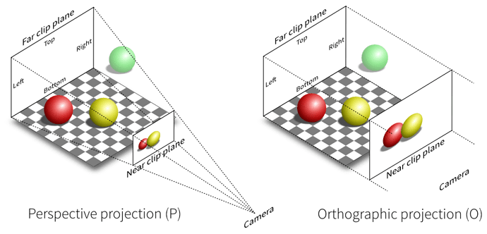
How a Camera Sees the World
© Sofiia Kuzmenko

Slide 8
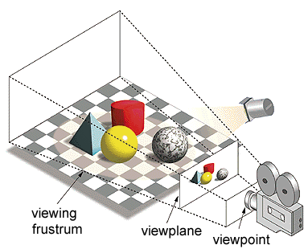
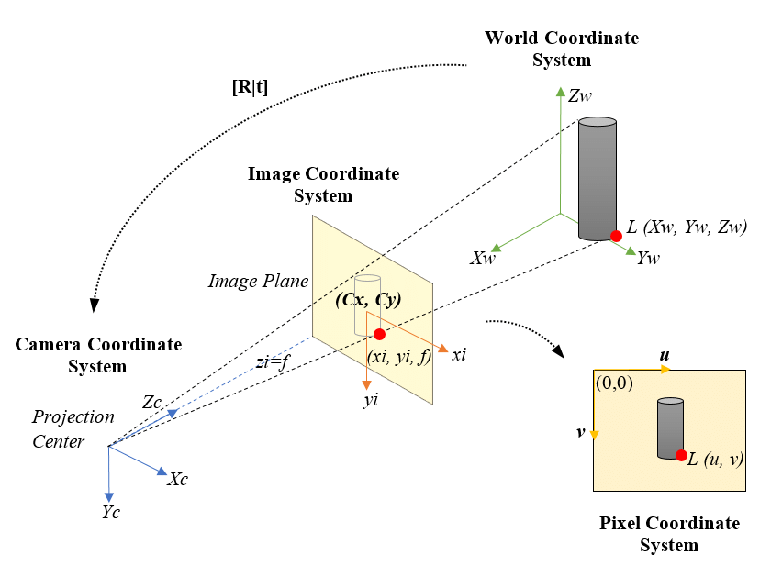
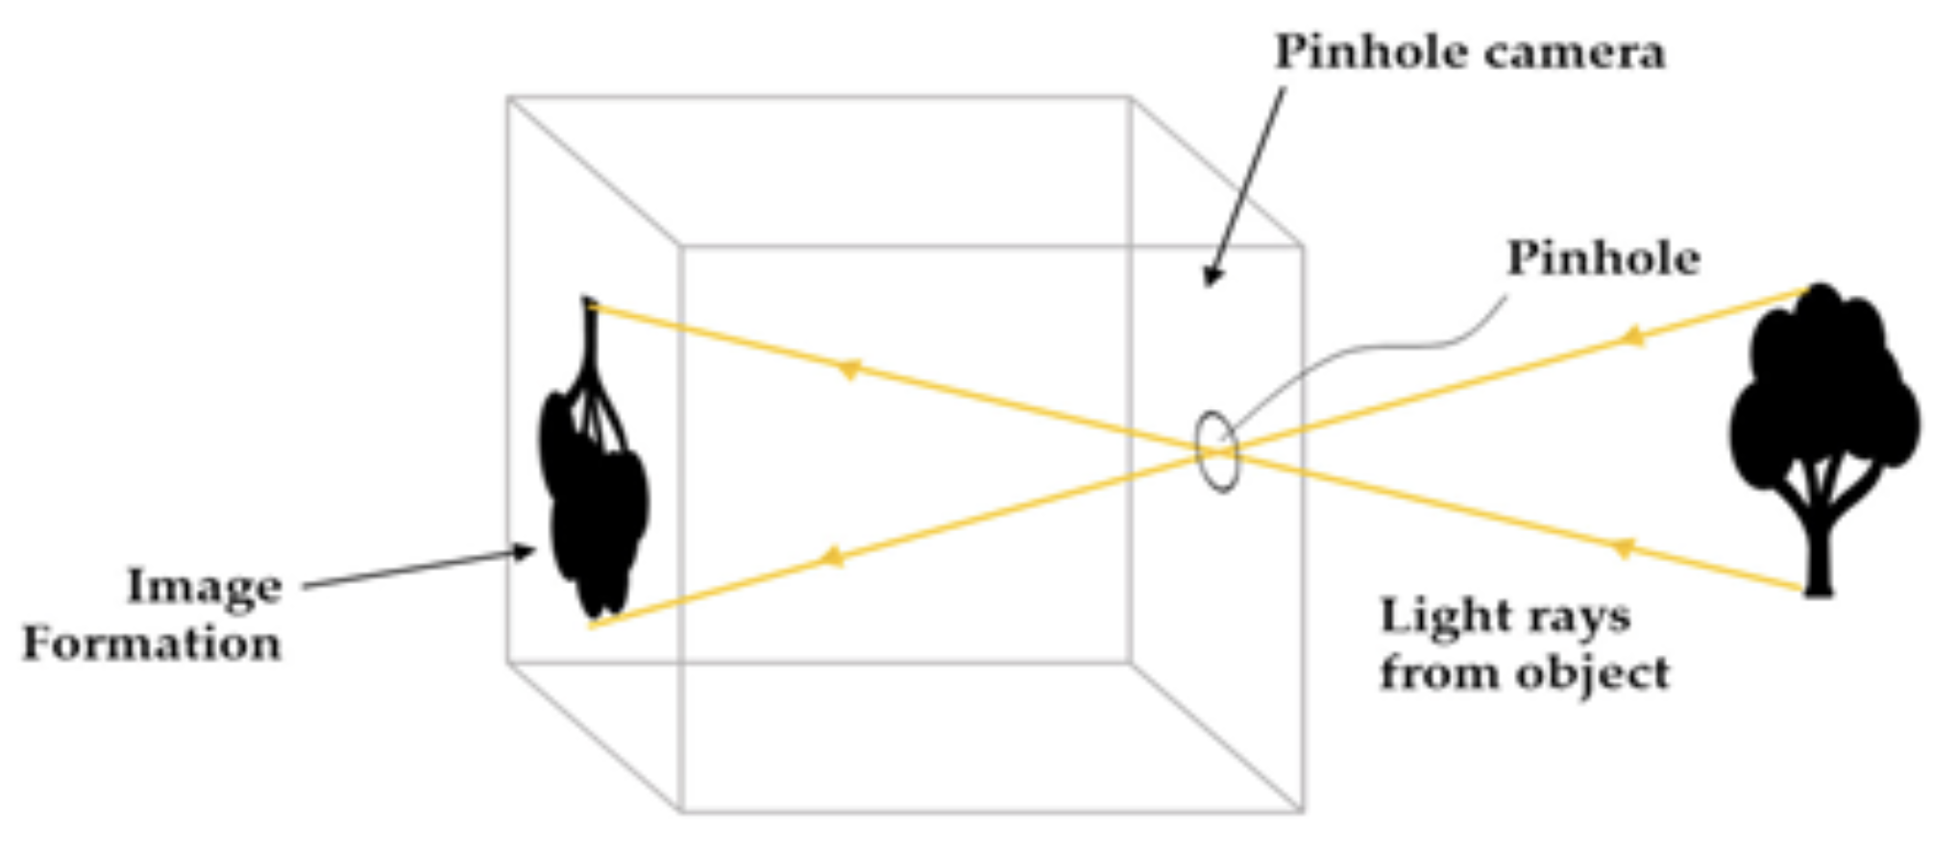
Pinhole Camera Model
Illustration of the pinhole model
Schematic of a simplified camera projection model:
yellow plane - representation of the image plane
© Sofiia Kuzmenko

Slide 9
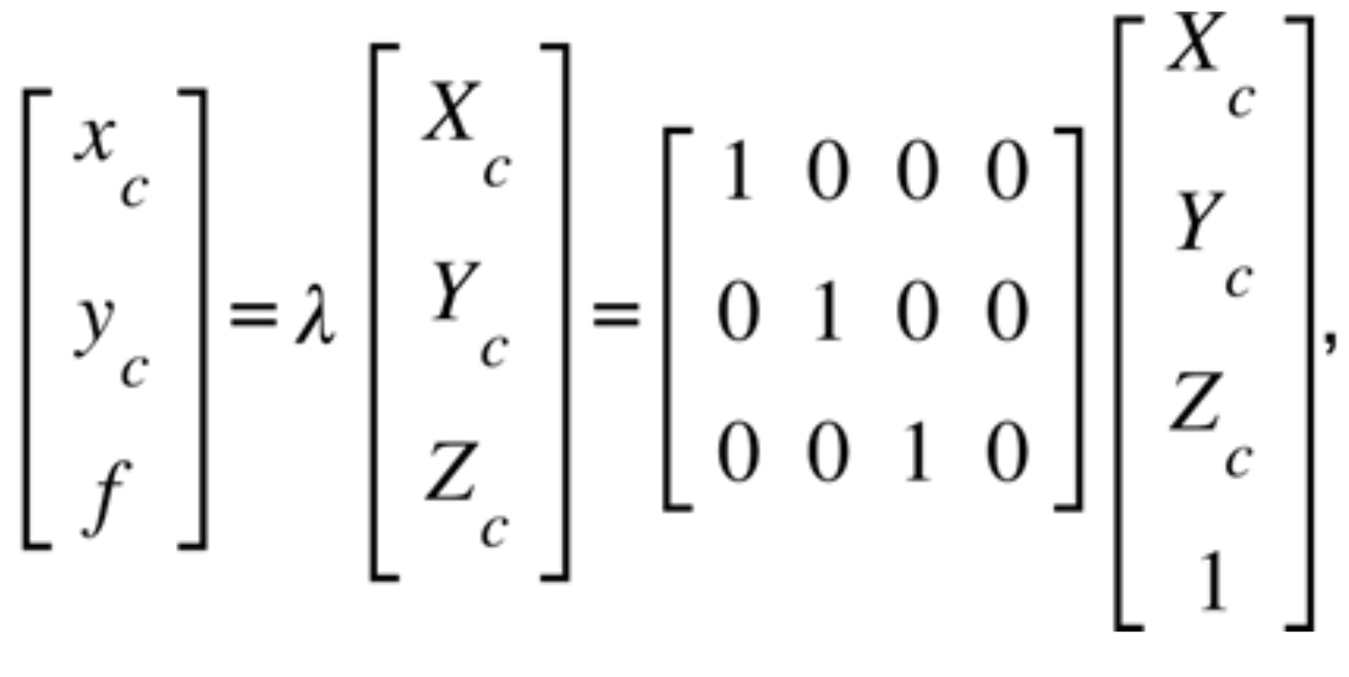
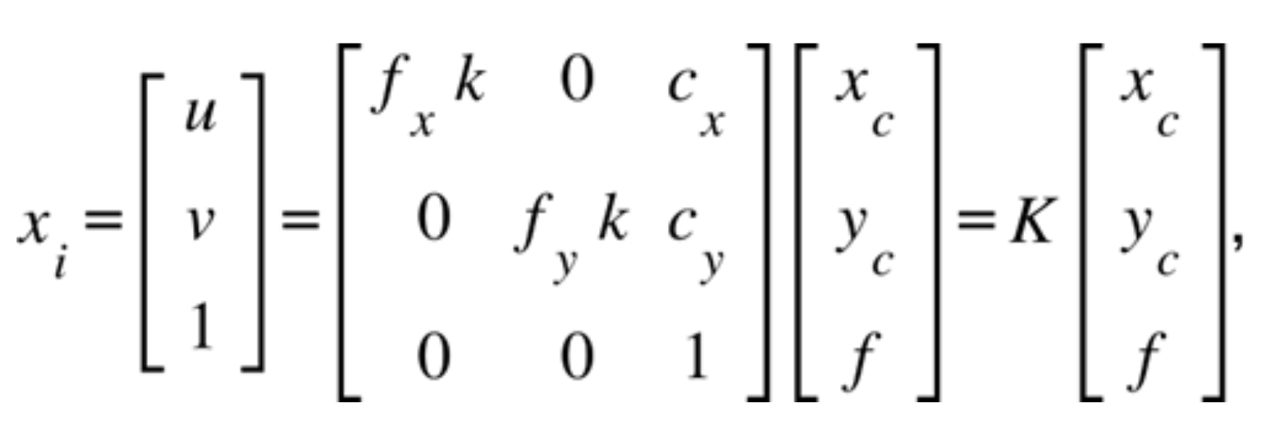
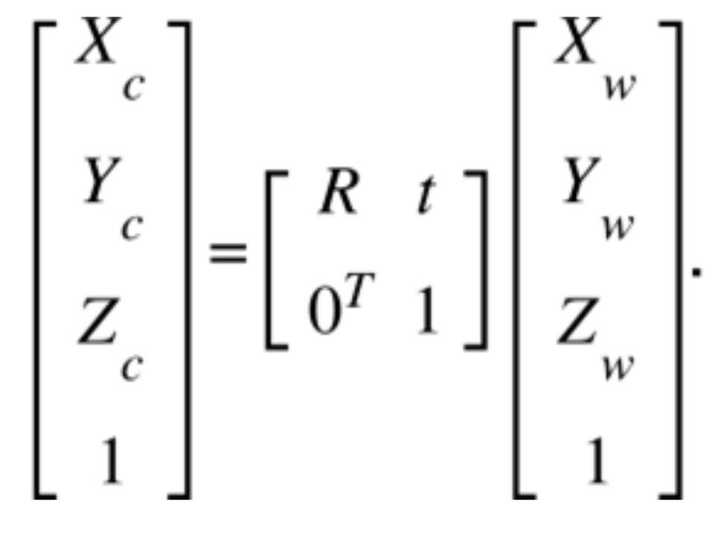
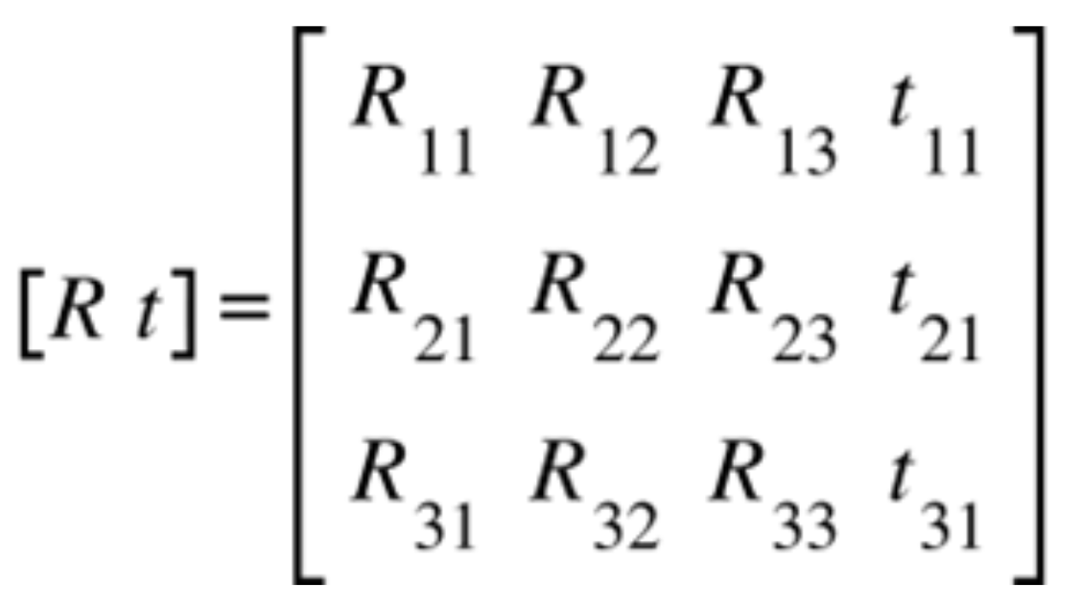
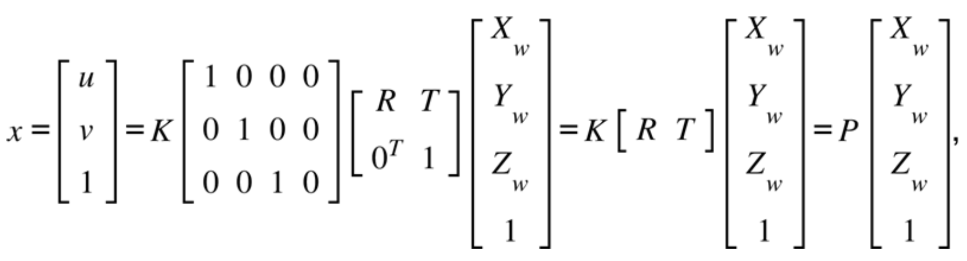
Pinhole Camera Model
Camera coordinate system
Image coordinate system
World coordinate system
Final equation for the relationship between 2D pixels and 3D coordinates
Schematic of a simplified camera projection model:
yellow plane - representation of the image plane
© Sofiia Kuzmenko

Slide 10
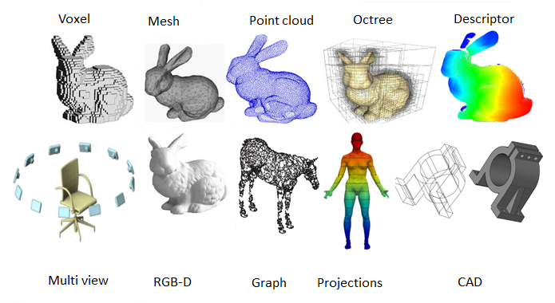
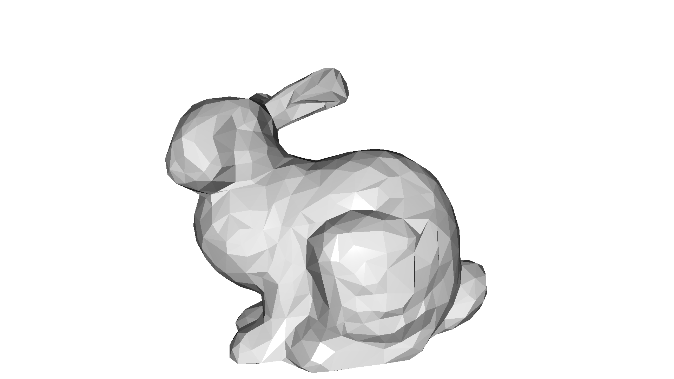
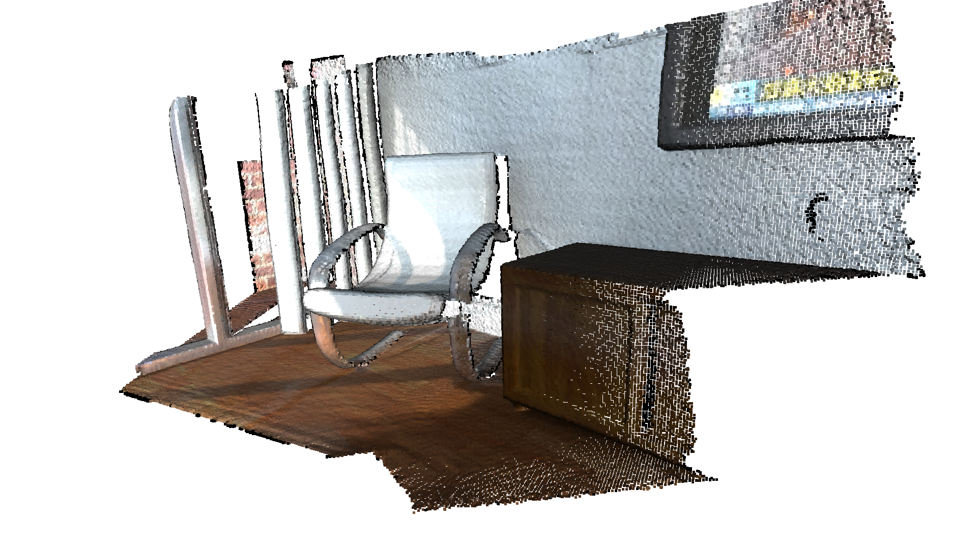
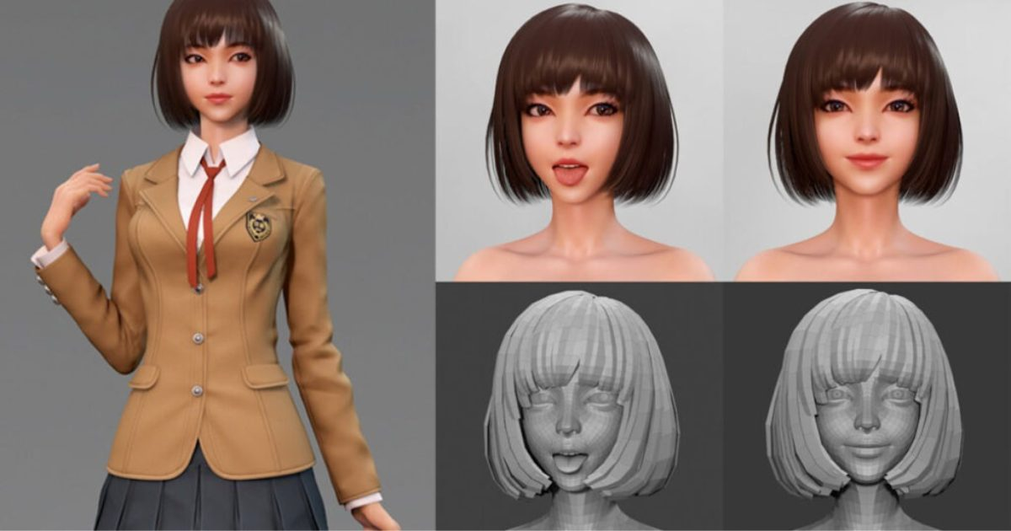
3D Structures for AR
Mathematical and visual representations of objects, surfaces, or environments in three-dimensional space.
Point Cloud
Mesh
3D Model
A collection of individual points in 3D space, each defined by its 𝑥, 𝑦, 𝑧 coordinates.
Composed of vertices, edges, and faces, forming a connected network that defines the shape and surface of an object
Combine geometric data (the shape of the object) with surface attributes (textures, colors, and materials)
© Sofiia Kuzmenko

Slide 11
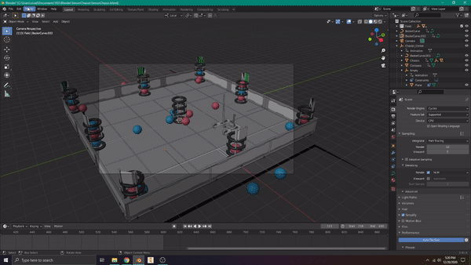
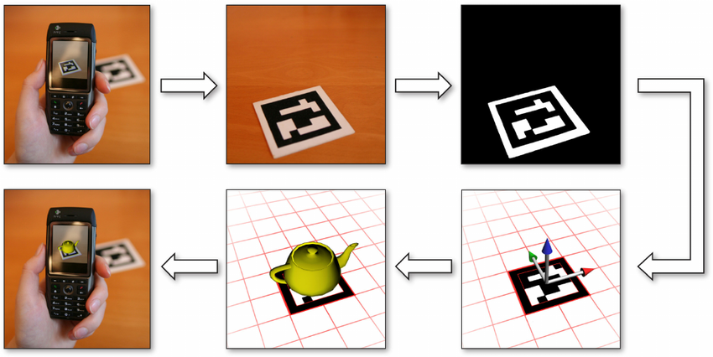
Rendering Virtual Objects
The process of generating a 2D image or animation from a 3D model.
Translates the geometry, materials, textures, lighting, and camera settings of a 3D scene into a visual representation that can be displayed on a screen.
Illustration of a 3D model rendering with Blender
Role of rendering in AR workflow
© Sofiia Kuzmenko

Slide 12
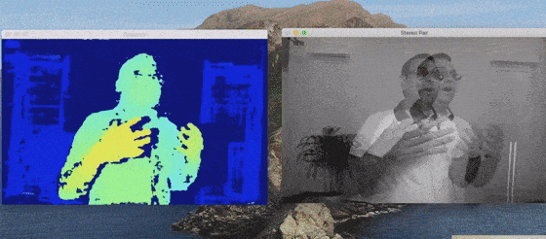
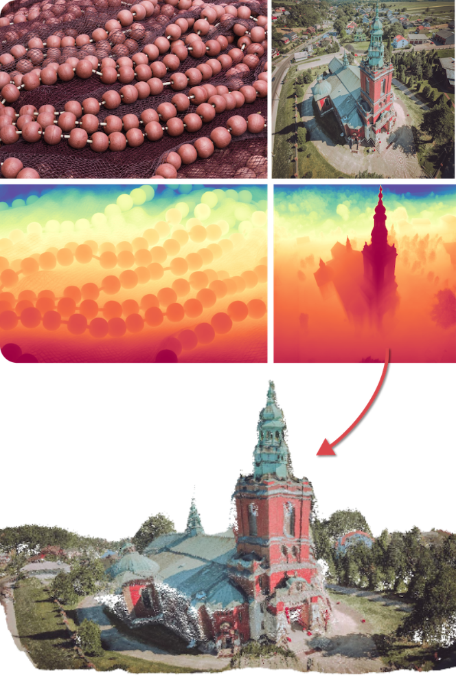
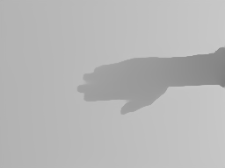
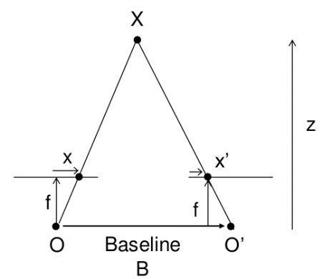
Depth Data
Provides information about the distance of objects in the real world from the camera.
Sources of Depth Data:
Stereo Cameras: Depth estimation from disparity between dual camera images.
LiDAR: Accurate depth sensing via laser-based measurements.
Monocular Depth Estimation: Uses AI models to infer depth from a single camera image.
Stereo Cameras
LiDAR
Monocular Depth Estimation
© Sofiia Kuzmenko

Slide 13
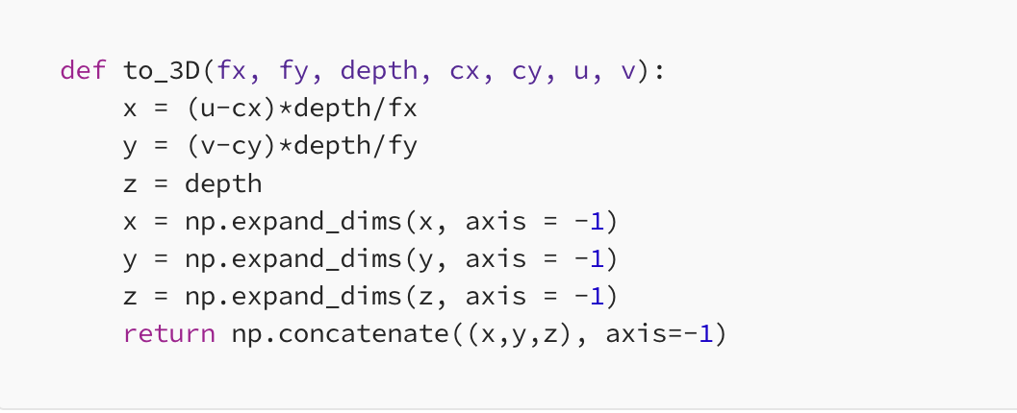
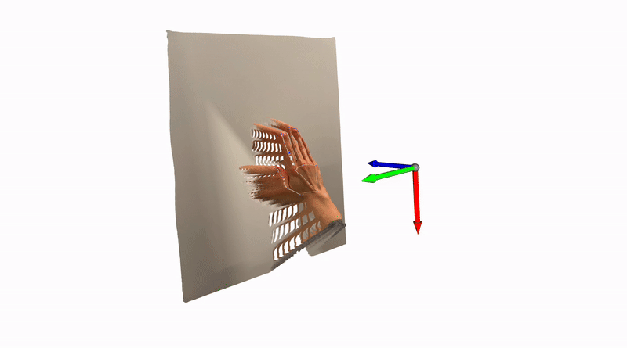
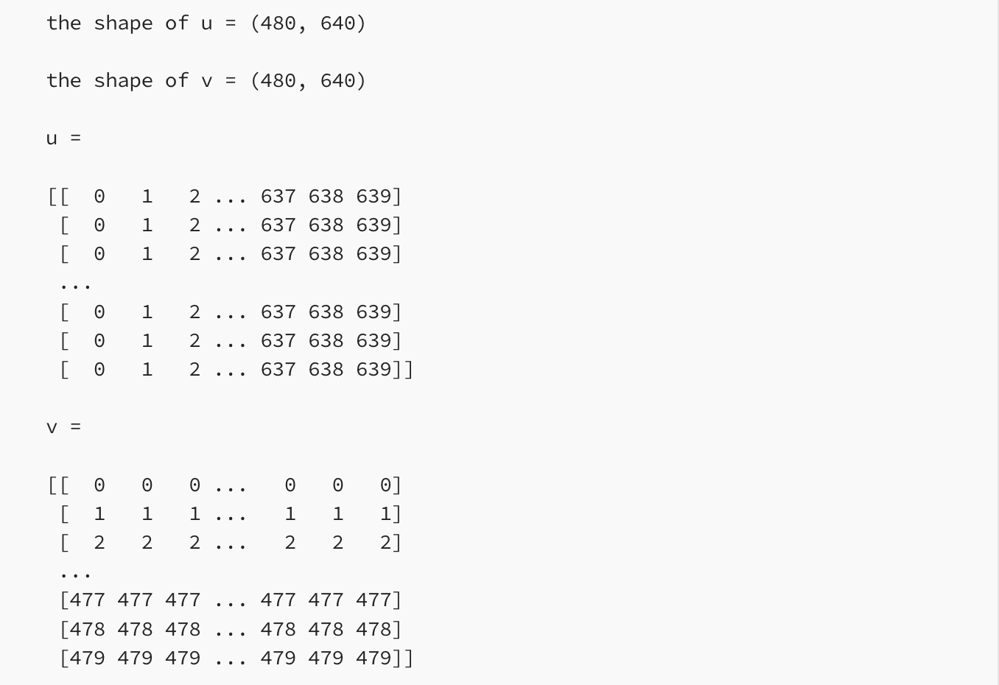
RGBD processing
Camera coordinate system
Image coordinate system
Illustration of reconstructed point cloud from RGBD at identity camera pose
© Sofiia Kuzmenko

Slide 14


Project Tasks & Requirements
Title:
Virtual Ring Try-On
Direction:
Computer Vision (CV)
including 3D domain
Deep Learning (DL)
Goal:
develop a computer vision system that enables users to virtually try on rings using augmented reality (AR).
General requirements:
the system should ensure accurate placement, realistic visualization of materials, and adaptability to different hand poses, lighting conditions, etc.

Slide 15
Description of the solution

Slide 16


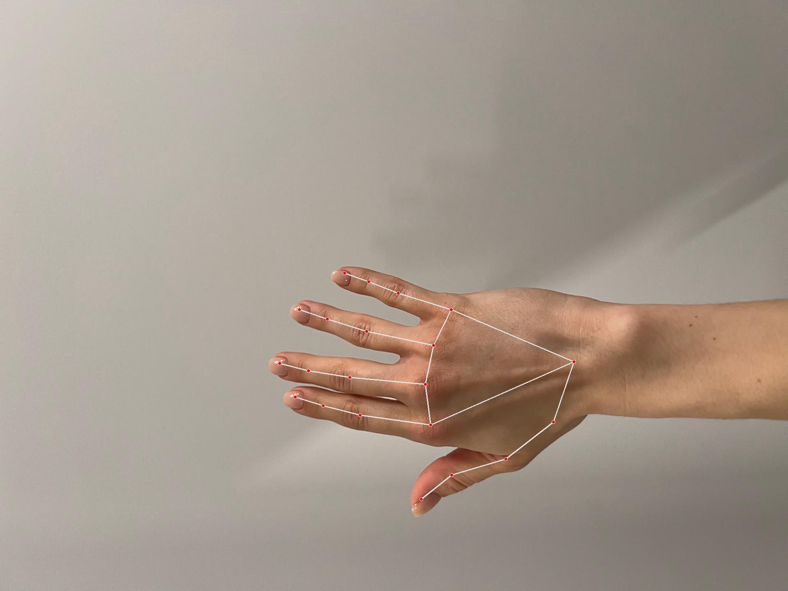
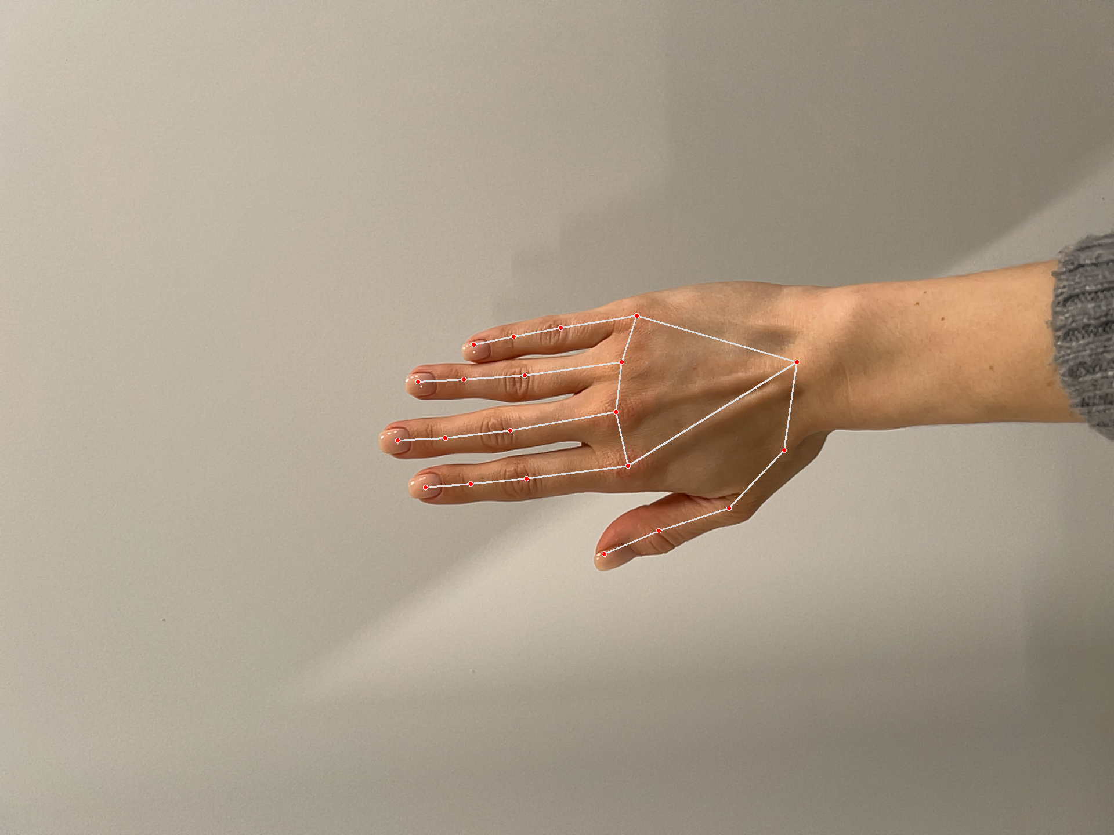
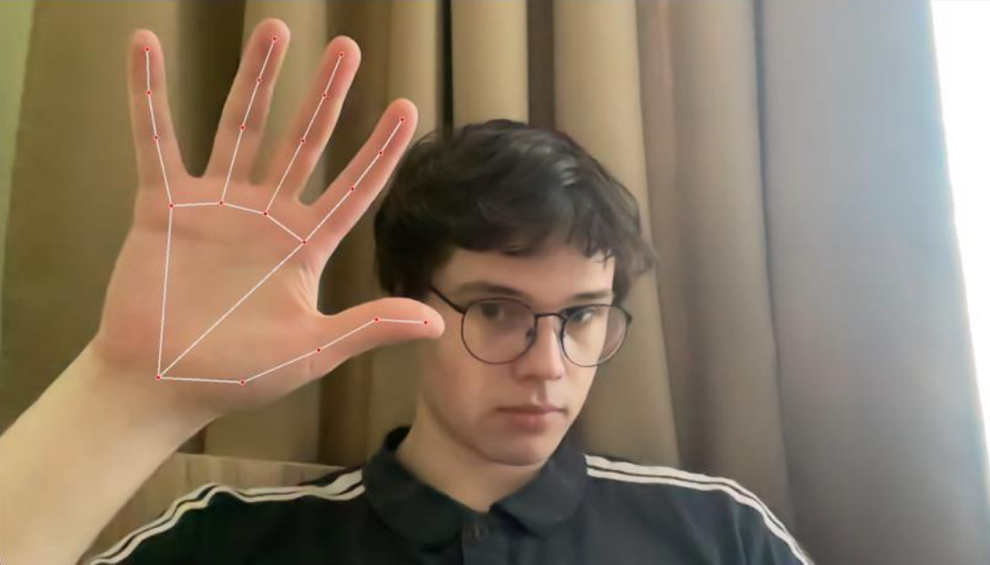
Hand localization on image

Slide 17

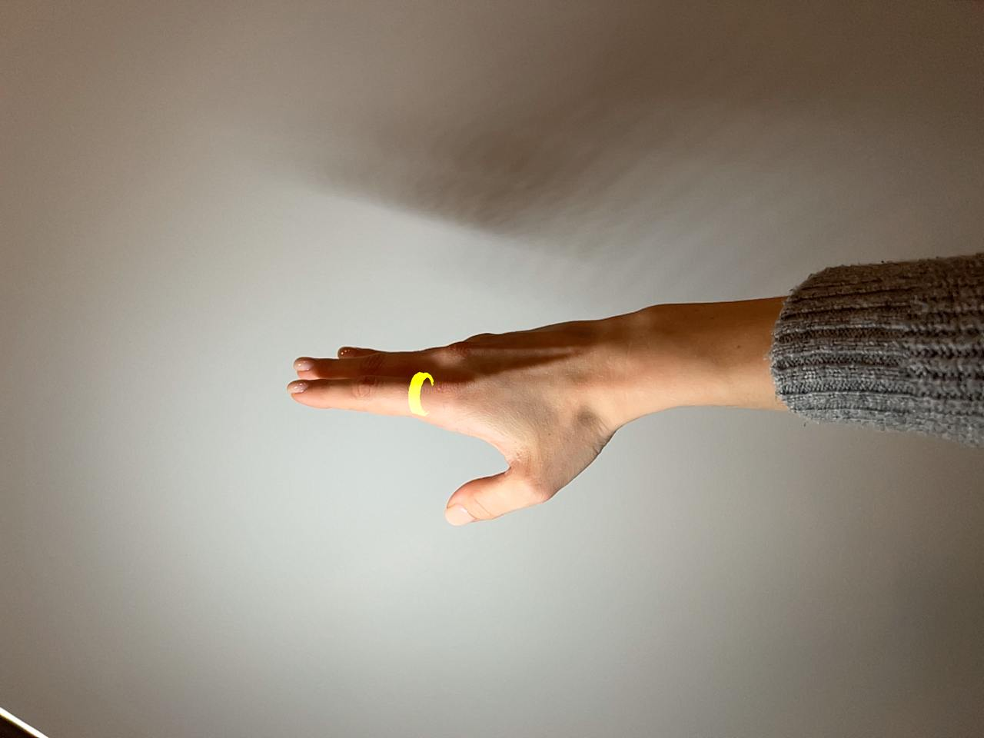


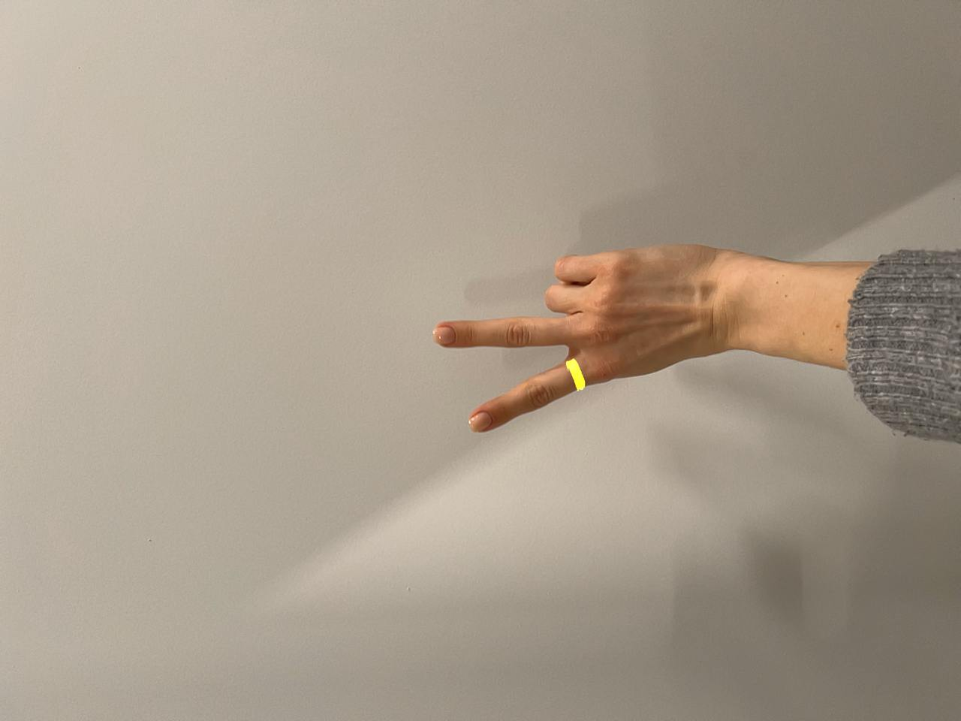
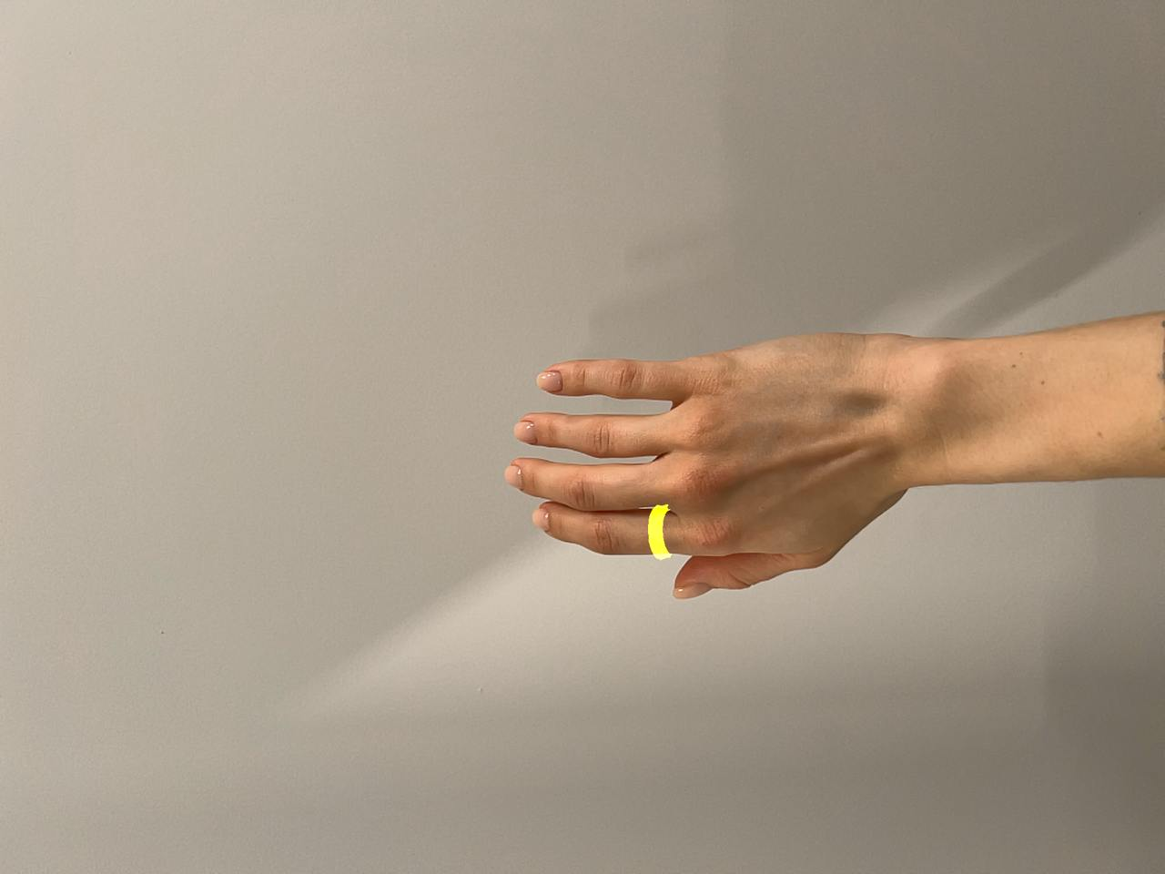
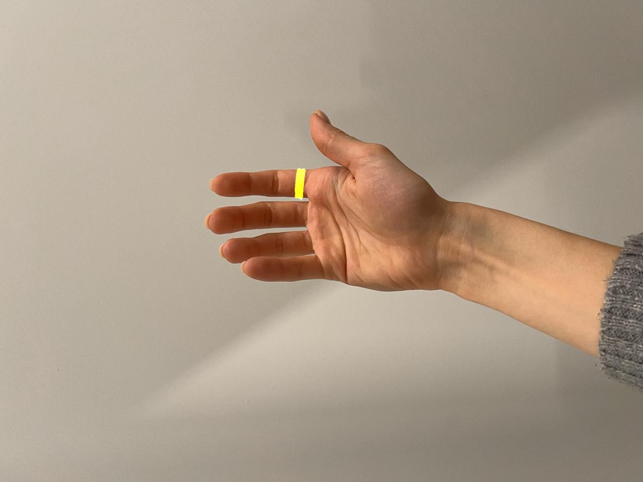
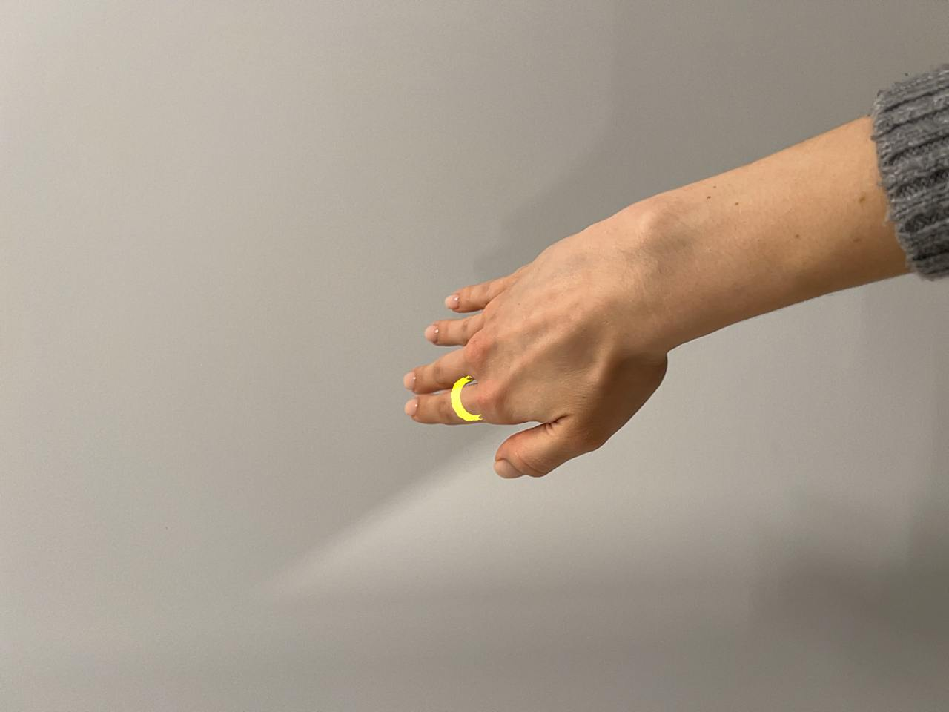
Ring Pose Estimation
RGBD reconstruction:
calculate 3d coordinates in camera system using depth maps.
define a basis by vectors made with neighbours fingers.
use the basis to define the ring pose.
apply the transformation
project ring on 2d image as an overlay

Slide 18
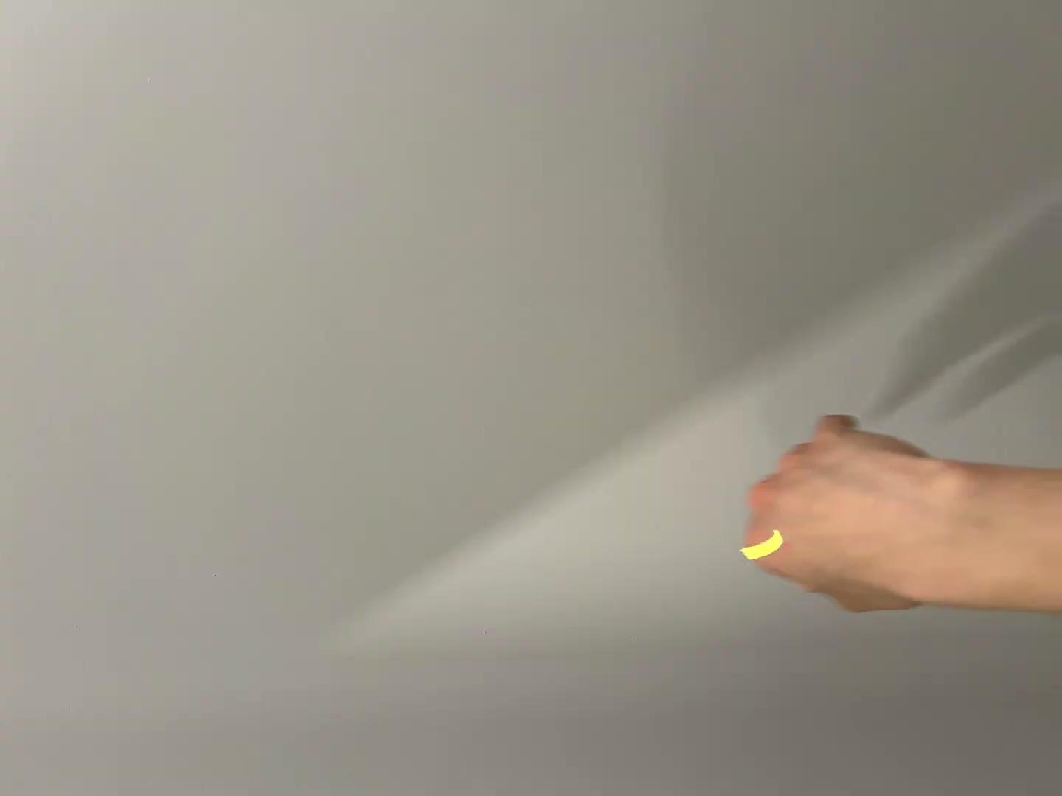
Result video
Technical requirements:
✅ the system should ensure accurate placement,
✅ adaptability to different hand poses,
🔁 realistic visualization of materials, lighting conditions

Slide 19
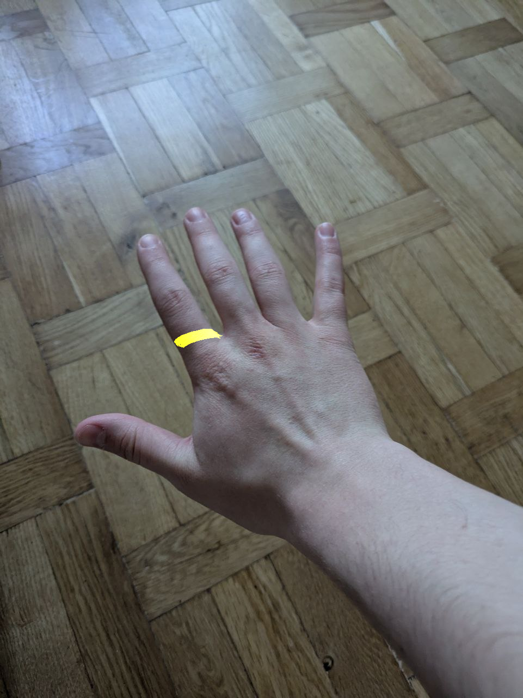
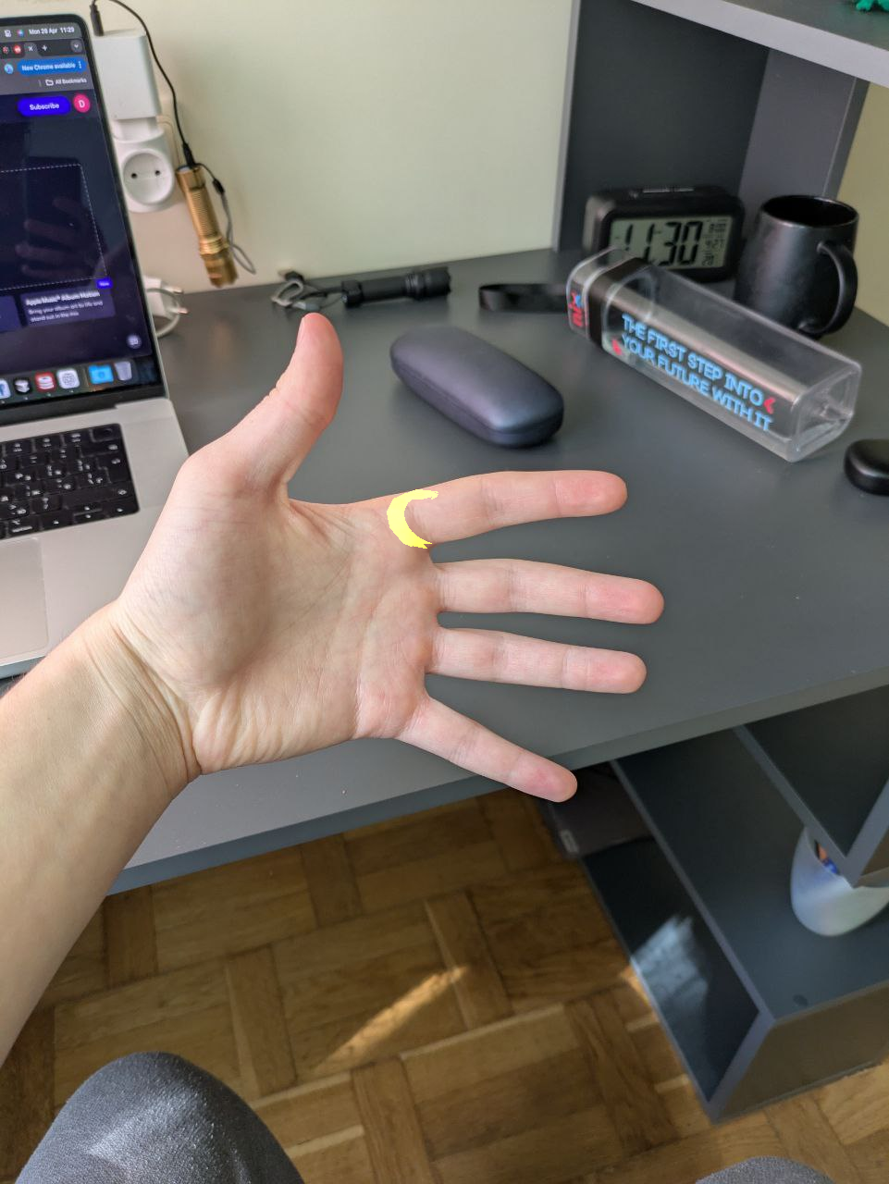
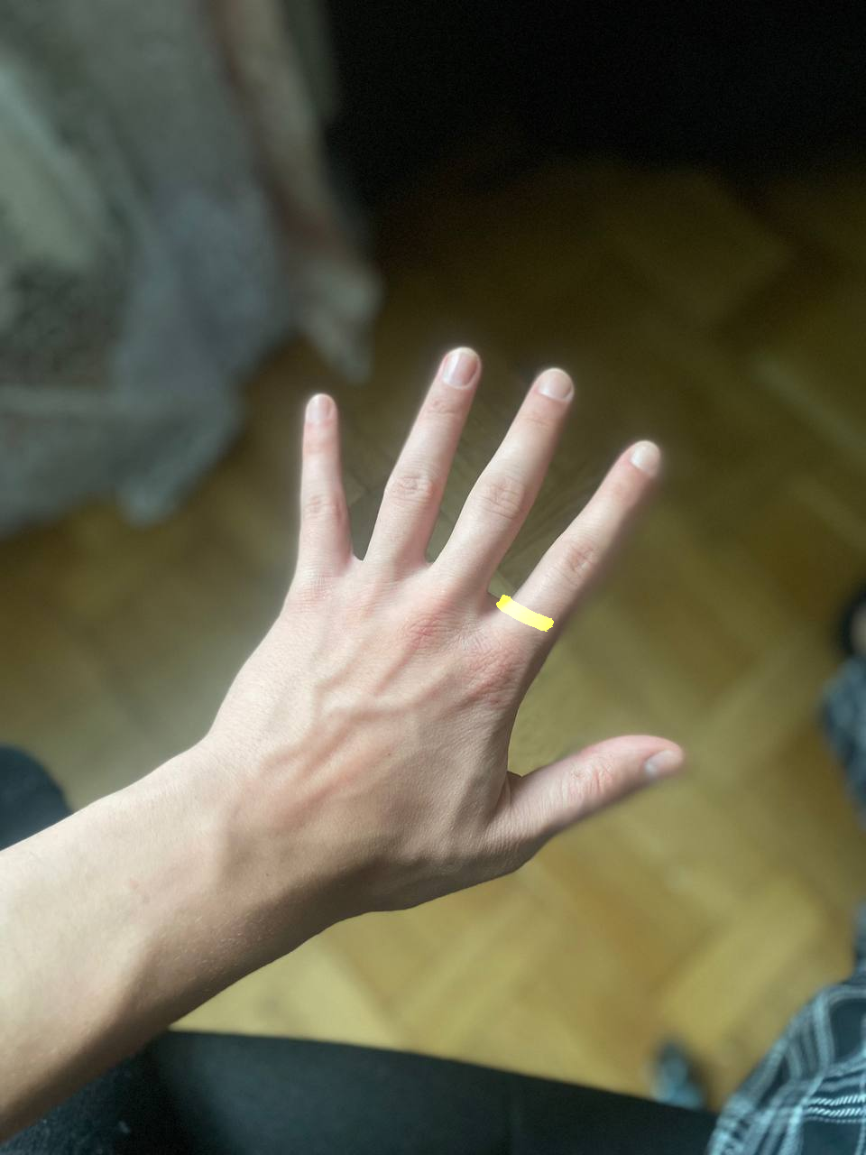
Interactive part

Slide 20
Useful Links
Linear Algebra:
3B1B course (highly recommended for great intuition)[0].
Hand localization on image:
Mediapipe tutorial [1].
Camera pose estimation:
Pinhole camera model: Presentation [2].
Pinhole camera model: Medium Longread [3], [4], [5].
Pinhole camera mode: Long story short [6].
Pose computation overview [7].
Point cloud generation with RGBD:
With open3d [8].
With custom implementation [9], [10].
3D structures:
Point clouds, meshes in general [11].
.obj structure [12], .glb structure [13].
Point cloud transformations [14].
3D Graphics Rendering:
with open3d [15], [16].
with pytorch3d [17], [18], [19].
with blender python API [20].
© Sofiia Kuzmenko

Slide 21

THANK YOU!

